Slide 1
Final Engagement
Attack, Defense & Analysis of a Vulnerable Network
Presented by Powerpuff Girls
Sushmaa Lingaraj, Bernice Asamoah, Morayo Lawal, Sooji Lee
September 13, 2021

Slide 2
Table of Contents
This document contains the following resources:
Network Topology & Critical Vulnerabilities
Exploits Used
Mitigation Strategies
Presented By Sooji
Presented by Morayo
Presented By Bernice
& Sushmaa

Slide 3

Network Topology
& Critical Vulnerabilities
3

Slide 4
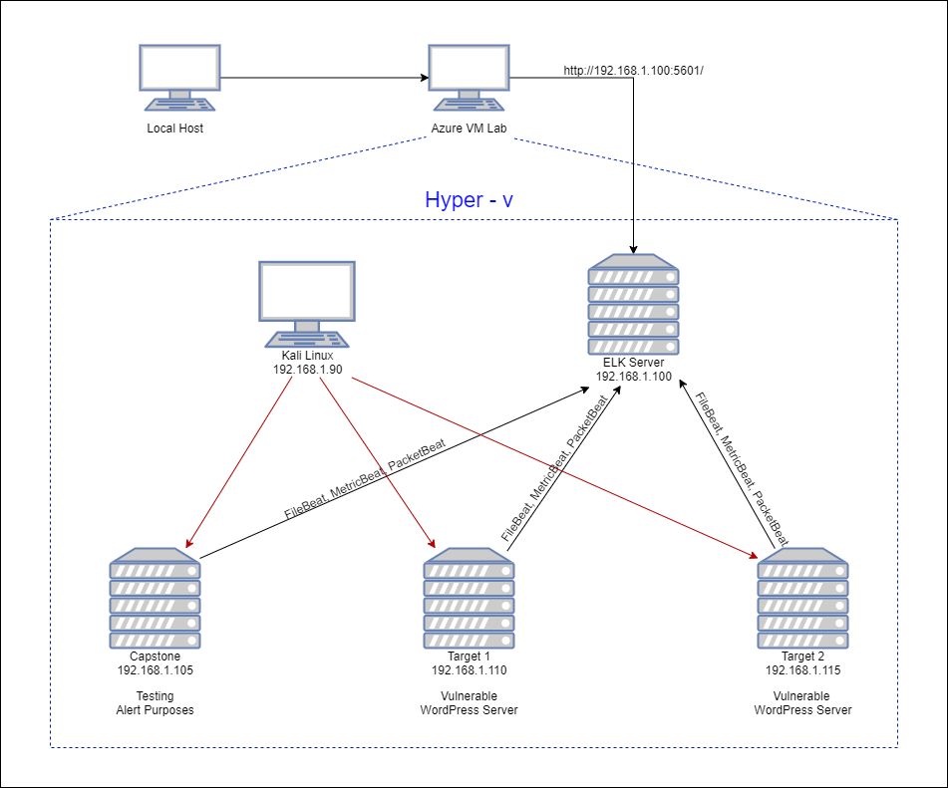
Network Topology
Network
Address Range: 192.168.1.0/24
Netmask: 255.255.255.0
Gateway: 192.168.1.1
Machines
IPv4: 192.168.1.90
OS: Linux 2.6.32
Hostname: Kali
IPv4: 192.168.1.100
OS: Linux
Hostname: ELK
IPv4: 192.168.1.105
OS:Linux
Hostname: Capstone
IPv4: 192.168.1.110
OS: Linux
Hostname: Target 1
IPv4: 192.168.1.115
OS: Linux
Hostname: Target 2

Slide 5
Critical Vulnerabilities: Target 1 (From WPScan)
Our assessment uncovered the following critical vulnerabilities in Target 1.
Vulnerability | Description | Impact
WordPress XMLRPC GHOST Vulnerability Scanner (CVE-2015-0235) | Used to determine if it is vulnerable to the GHOST using WordPress XMLRPC interface | If vulnerable, system will segfault (segmentation fault - where unauthorized is trying to get into memory system) and return a server error
WordPress XMLRPC DoS (CVE-2014-5266) | Vulnerable to XML based denial of service | Web Server can have an effect in availability (CIA Triad)
WordPress XML-RPC Username/Password Login Scanner (CVE-1999-0502) | Attempts to authenticate against Wordpress-site (via XMLRPC) using different combinations | Brute Force attack can be done to get the username & password of the web server for authentication
WordPress XML RPC Pingback API / Pingback Locator (CVE-2013-0235) | Allows attackers to send HTTP request to intranet servers for port-scanning attack. | One server can expose all the internal server composition

Slide 6
Critical Vulnerabilities: Target 1
Our assessment uncovered the following critical vulnerabilities in Target 1.
Vulnerability | Description | Impact
Wordpress User Enumeration | WPScan detect the list of users with the specific options used (-u) | Unauthorized can get the username to target the specific account.
Open Port 22 SSH & Weak Password | Having Port 22 SSH open, anyone with the username and password can get into the system | Anyone can brute force attack the authentication for the system
Sensitive Data Exposure/ wp-config.php & SQL Database | SQL Database Configuration in Plaintext | Once the config file is seen, anyone can grab the Id & pw. Better protect it with encryption.
Python sudo privileges | User is given access to sudo privileges via Python | Attacker can escalate to root privileges easily gaining access to the system

Slide 7
Exploits Used
7

Slide 8
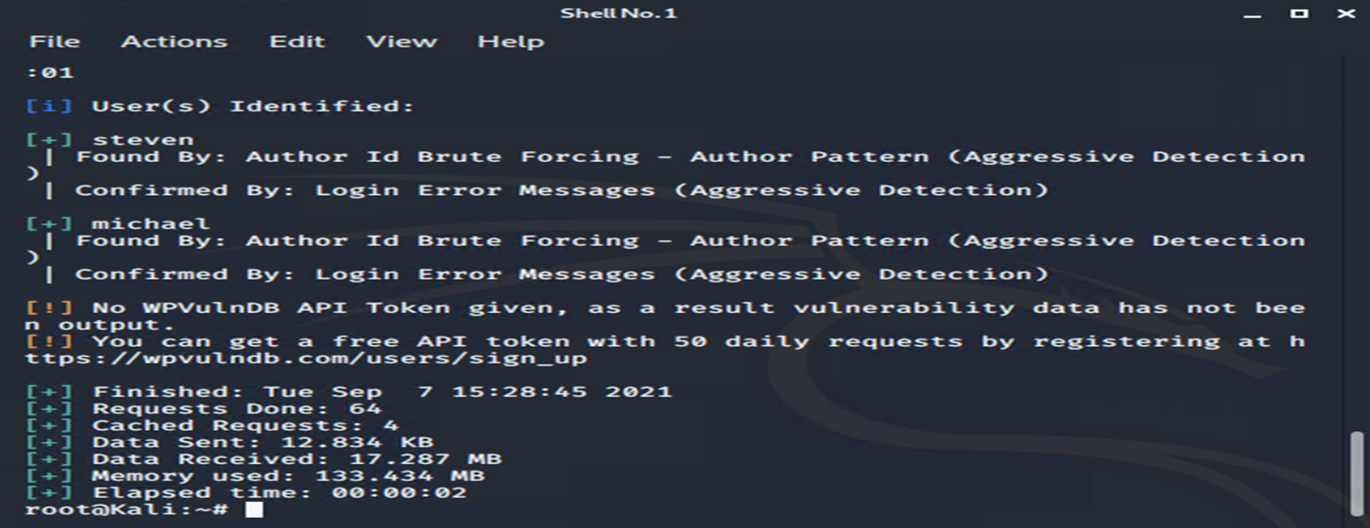
Exploitation: Wordpress User Enumeration
WPScan was used to find the 2 users: Michael and Steven wpscan
–-url http://192.168.1.110/wordpress -eu

Slide 9
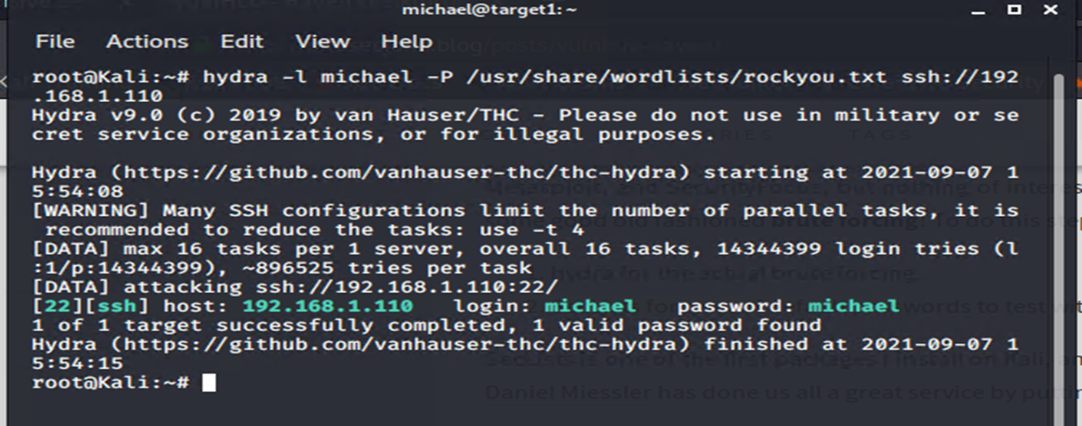
Exploitation: Open Port 22 SSH & Weak Password
Hydra was used to get Michael’s password

Slide 10
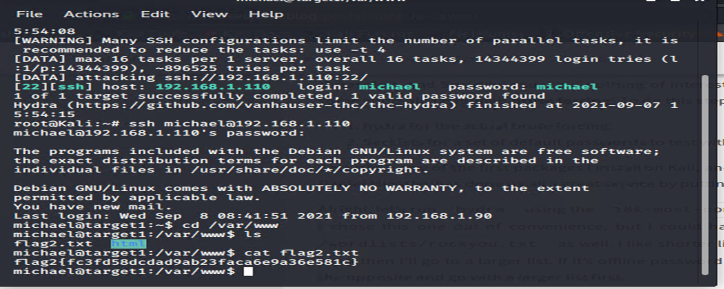
Exploitation: Open Port 22 SSH & Weak Password
Use SSH to gain a user shell – Michael. Was able to access files through Michael’s account.

Slide 11
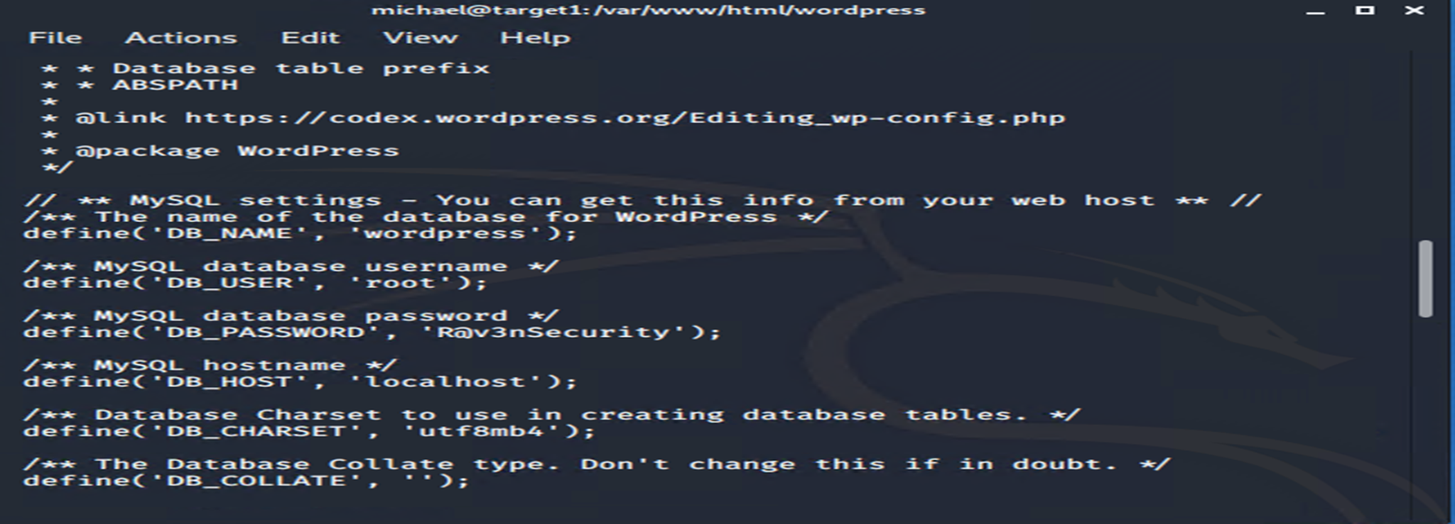
Exploitation: Sensitive Data Exposure
Discovered the wordpress directory there is a wp-config.php file. Found the username is root and the password is R@v3nSecurity

Slide 12
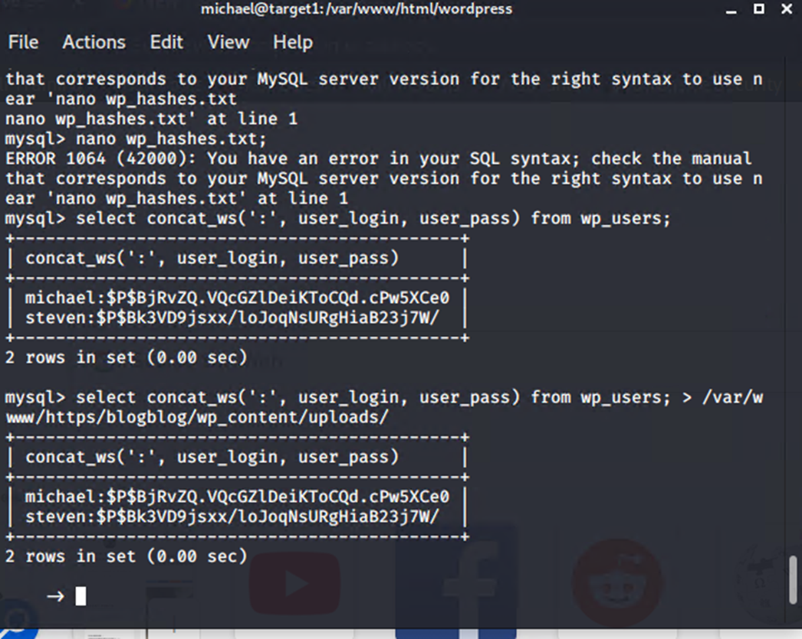
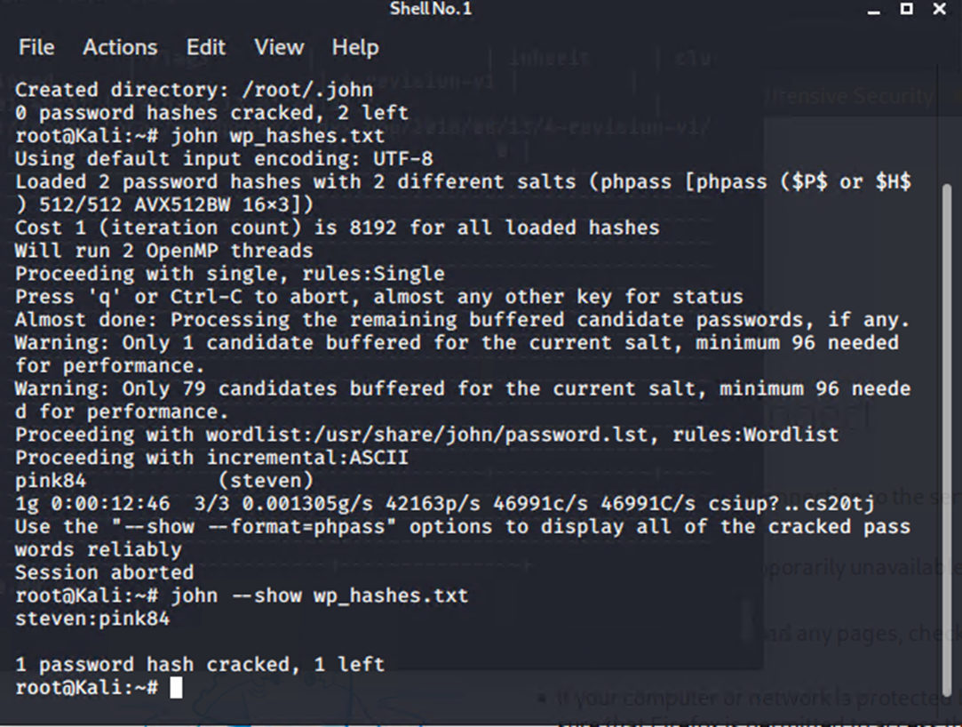
Exploitation: Sensitive Data Exposure
Password Hash With Insufficient Computational Effort
From the wp_users, we can see both users Michael and Steven, and their corresponding hashes. John the ripper was used to crack the hashes

Slide 13
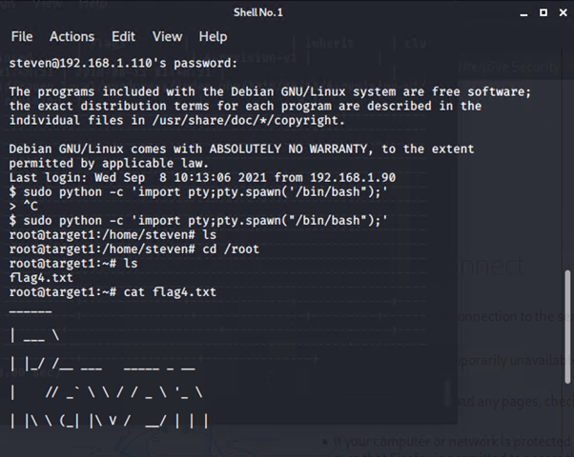
Exploitation: Python Sudo Privileges
Once we got into Steven’s password from John, we exploited Steven’s account
Exploited Steven’s python sudo privileges through a spawn shell
Achieved root access

Slide 14
Mitigation Strategies
14

Slide 15
Stealth Exploitation of (Wordpress User Enumeration)
Monitoring Overview
This alerts detection was used for this exploit:
WHEN count () GROUPED OVER top 5 “http.response_status_code IS ABOVE 400 FOR THE LAST 5 minutes
packetbeat-http.response_status_code metrics was used
above 400 FOR THE LAST 5 MINUTES threshold was fired at.
Mitigating Detection
You can disable User Enumeration in Wordpress by using free plugin “WP Hardening”
Install and activate plugin > ‘Security Fixers’ tab > Stop user enumeration
Underline factor is to educate the employees to use the stronger passwords for security purposes. (not using the same pw as id, like michael)
Company should also imply a policy for password change every 3-6 months.

Slide 16

Stealth Exploitation of [Open Ports 22 SSH]
Monitoring Overview
SSH Login Alert would detect this exploit
Monitor SSH Port for unauthorized access
Triggers when user attempts to access system over Port 22
Mitigating Detection
The best mitigation for this exploit would be closing the Port 22.
However, there might be times when you would need Port 22 open.
If this is the case, we can create whitelisting of IPs so that only authorized can access the Port 22

Slide 17

Stealth Exploitation of (Sensitive Data Exposure)
Monitoring Overview
Alert when SQL Database has gained access with unauthorized personnel.
Triggers external/unauthorized IP connections that are made to the SQL database or any other sensitive files (like wp-config.php file)
Mitigating Detection
Have all the sensitive data encrypted, not in plaintext
This will have the data not easily accessible
Only whitelist the IPs that are being logged in
for SQL database (ex. Administrators)

Slide 18

Stealth Exploitation of (Python Sudo Privileges)
Monitoring Overview
Privilege Escalation Alert
Monitor for unauthorized root access attempts, as well as “super-doer” activity
Triggers when unauthorized sudo command usage or privileged directory access is attempted by unauthorized users.
Mitigating Detection
Only authorize Sudo Privileges to the select few
(Ex. Administrators)
For example, remove Python Sudo Privileges
from Steven’s account.

Slide 19
References:
Rapid7 (May, 2018) WordPress XMLRPC GHOST Vulnerability Scanner Retreived from https://www.rapid7.com/db/modules/auxiliary/scanner/http/wordpress_ghost_scanner/
Rapid7 (May, 2018) WordPress XMLRPC DoS Retreived from https://www.rapid7.com/db/modules/auxiliary/dos/http/wordpress_xmlrpc_dos/
Rapid7 (May, 2018) WordPress XML-RPC Username/Password Login Scanner Retreived from https://www.rapid7.com/db/modules/auxiliary/scanner/http/wordpress_xmlrpc_login/
National Vulnerability Database (Aug, 2013) CVE-2013-0235 Detail Retrieved from https://nvd.nist.gov/vuln/detail/CVE-2013-0235
cve.mitre.org (Sept, 2021) CVE-2016-10033 Retrieved from https://cve.mitre.org/cgi-bin/cvename.cgi?name=CVE-2016-10033
Vikas Kundu (Aug, 2021) How to Stop User Enumeration in WordPress? Retrieved from https://www.getastra.com/blog/cms/wordpress-security/stop-user-enumeration/

